Slide 1

Web Proxy
Huang Hao, Zhou Yitong, Meng Yu, Chen Zijie, Wen Tianshu
2024.11.29

Slide 2
CONTENTS
Introduction of web proxy
01 Introduction
Divide of tasks
02 client & server
CONTENTS
03 proxy
04 Test
05 Conclusion

Slide 3
01
PART
Introduction

Slide 4






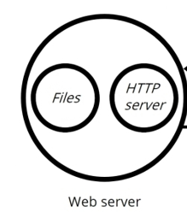
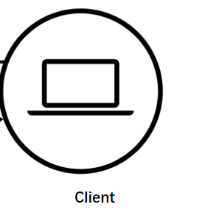
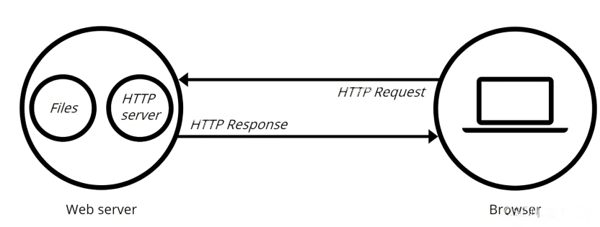


Prepare
client&server
proxy
test
conclusion
Web Proxy working flow
Request
Request
Web proxy
Web proxy
Web Proxy
Web Server
Response
Response
Client
The client can talk with the proxy, and then the proxy communicates with the server on behalf of the client.

Slide 5
Prepare
client&server
proxy
test
conclusion
Why we use web proxy
Request
Request
Web proxy
Response
Response
Advantage:
Access control
Access Restrictions : Only allow to access the whitelist sites.
Firewall : Form a firewall to ensure network security.
Improving efficiency
Web Caching :The next visit directly, faster.
Reverse Proxy : Proxy acts as a server to obtain content from other servers, efficient and fast
Privacy protection
Identity Hiding : Hide user identity information.

Slide 6
Prepare
client&server
proxy
test
conclusion
Division of tasks
Huang Hao(presentor)
Getting through the code framework
UI design
testing
Wen Tianshu
server design
client design
Zhou Yitong
Task framework design
proxy design
Chen Zijie
concurrent control
client design
Meng Yu
proxy design
Functional testing

Slide 7
02
PART
client & server

Slide 8


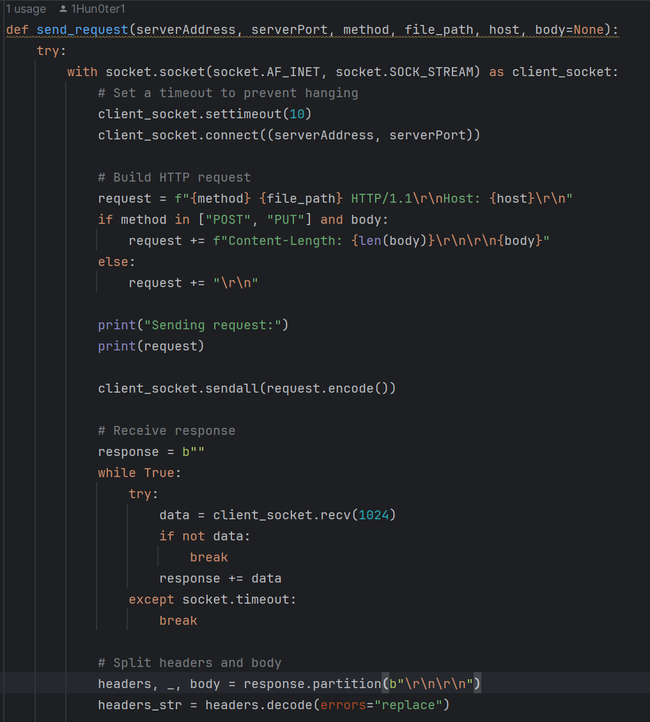
Prepare
client&server
proxy
test
conclusion
Client
1. Set the socket
2. Connect to the proxy
3. Build HTTP request
4. Send to proxy
5. Receive from proxy
6. Decode the response

Slide 9
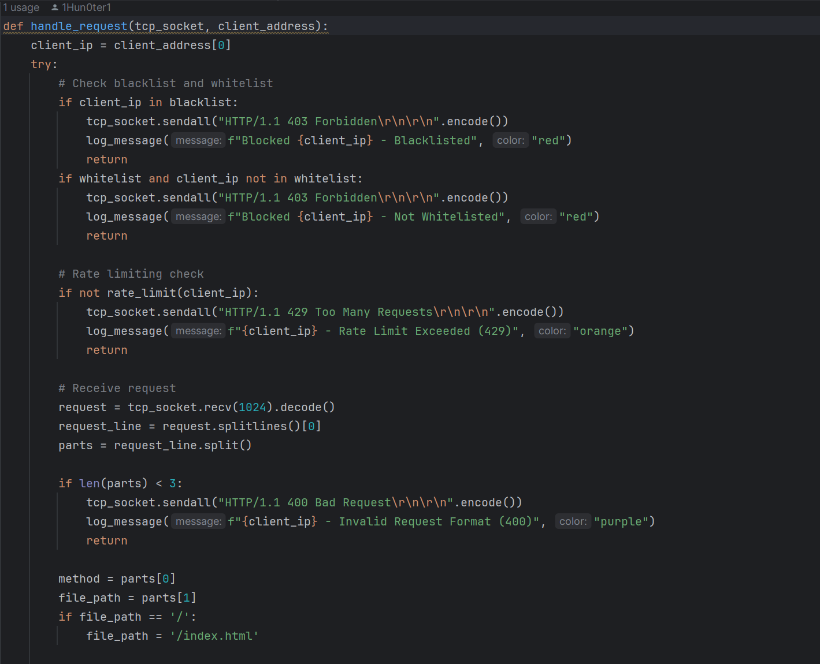
Prepare
client&server
proxy
test
conclusion
Server
1.* Safety set
2.* Rate control
3. Decode the request from proxy

Slide 10
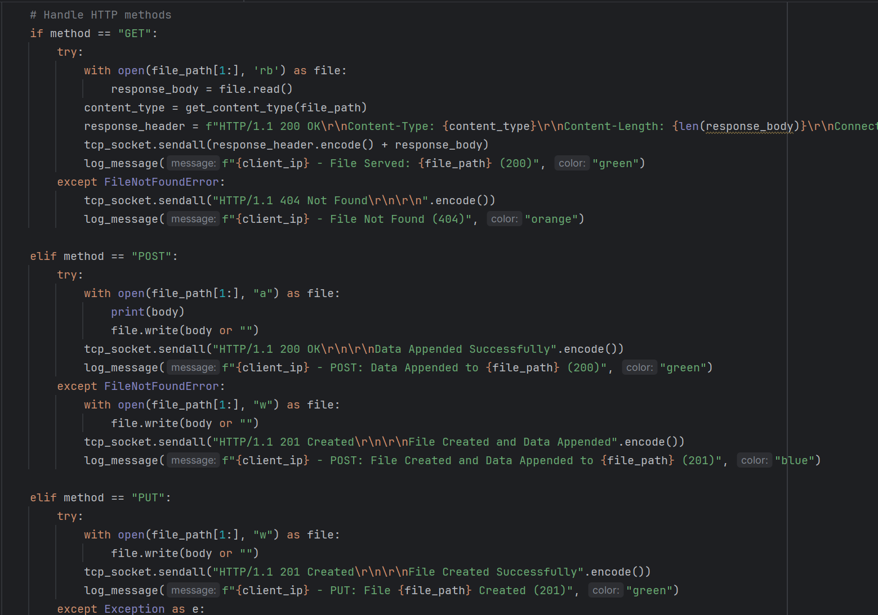
Prepare
client&server
proxy
test
conclusion
Tackle with different methods
1. GET
2.* POST
3.* PUT

Slide 11
03
PART
proxy

Slide 12





Prepare
client&server
proxy
test
conclusion
Summary of Key Logic
Response
Web proxy
Response
Request
Request
Request
Response
local
cache

Slide 13
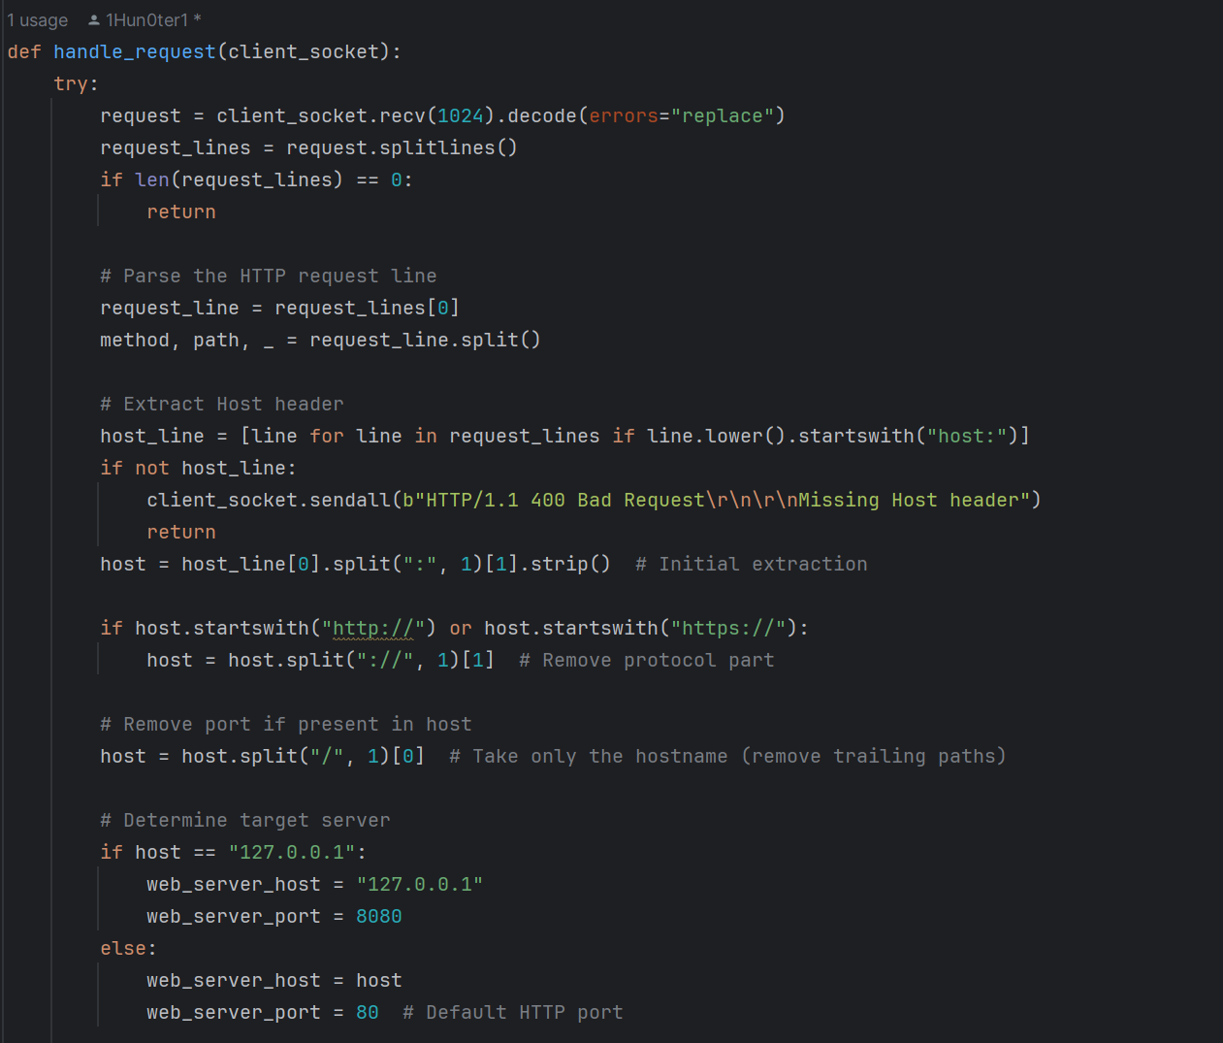
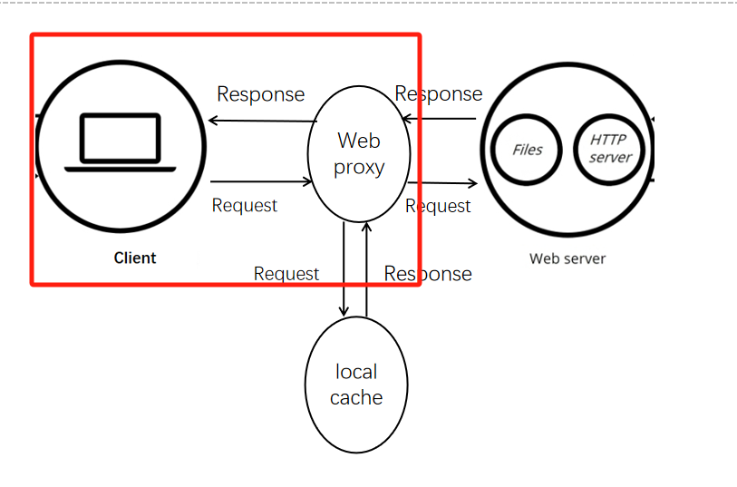
Prepare
client&server
proxy
test
conclusion
Act as client & server
Fetch from client & Send to client

Slide 14
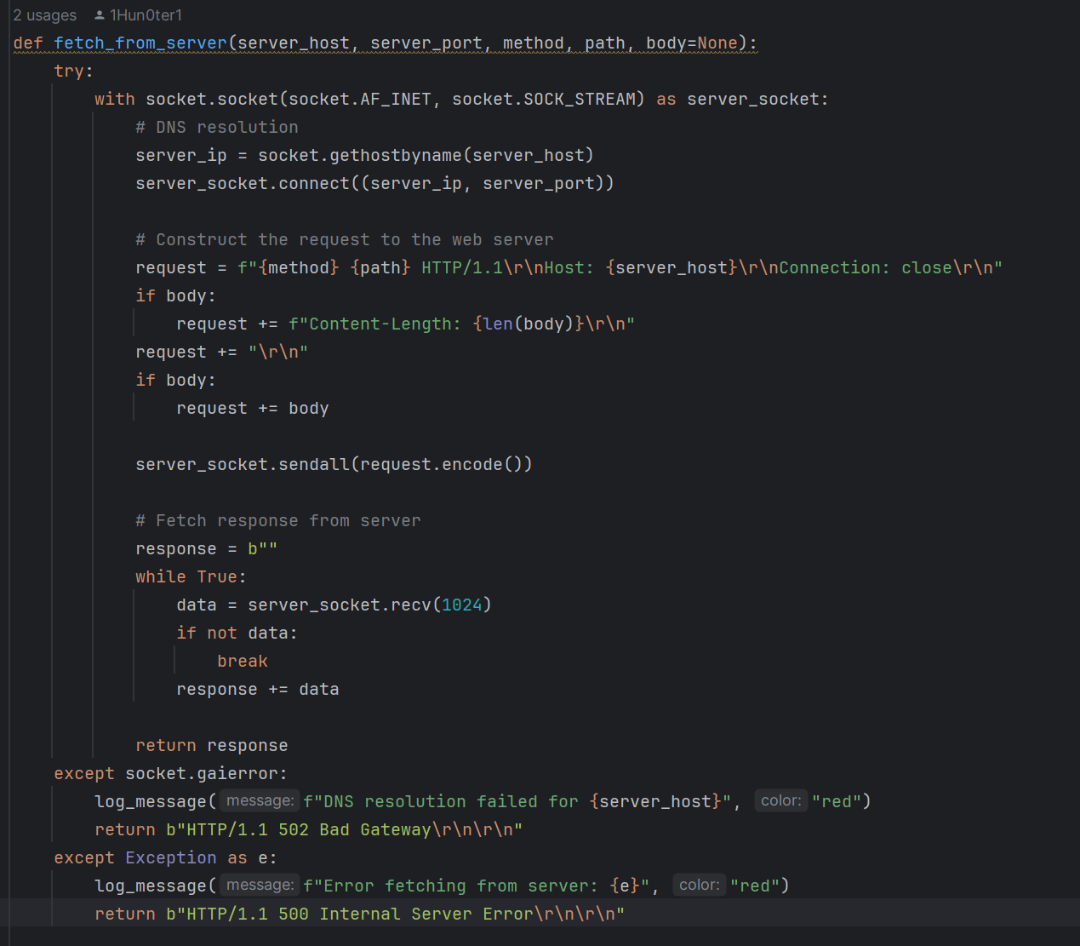
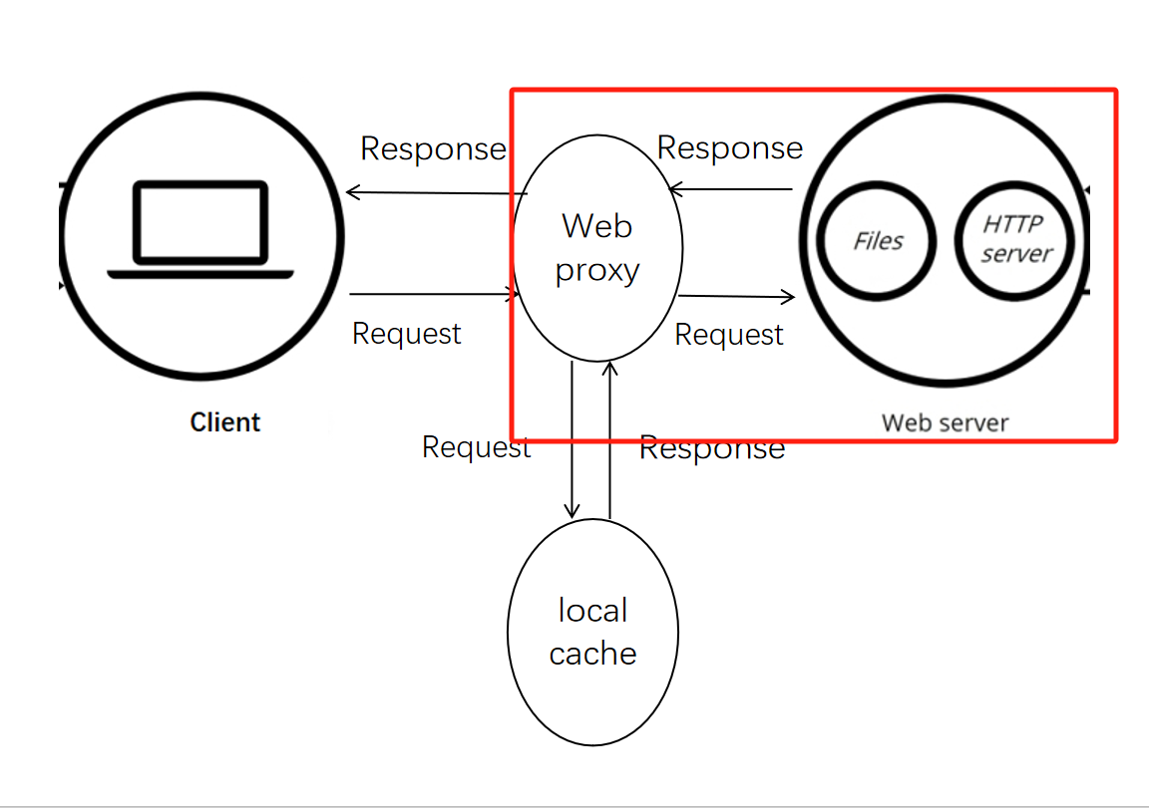
Prepare
client&server
proxy
test
conclusion
Act as client & server
Sent to server & Fetch from server

Slide 15
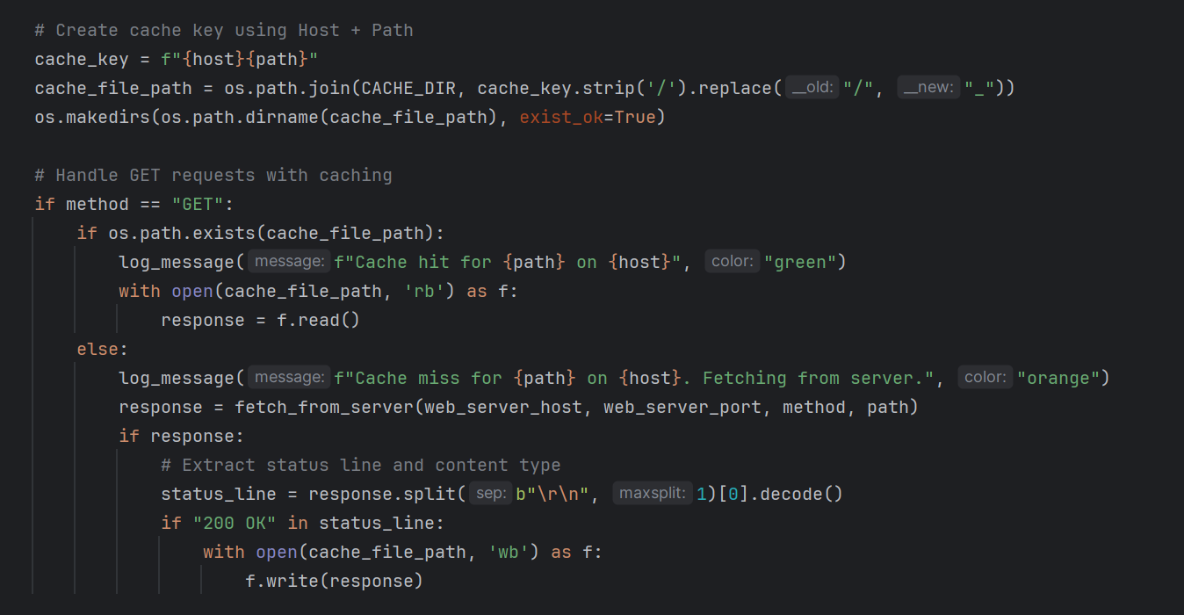
Prepare
client&server
proxy
test
conclusion
Cache design
Object url: host + path
Cache hit
Cache miss
&
write to cache

Slide 16
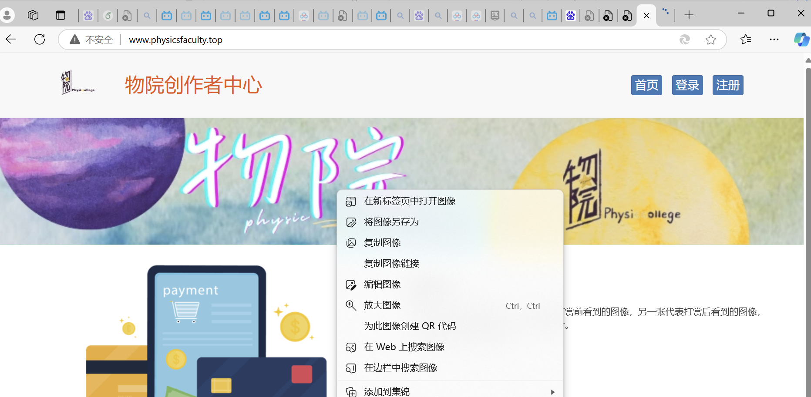
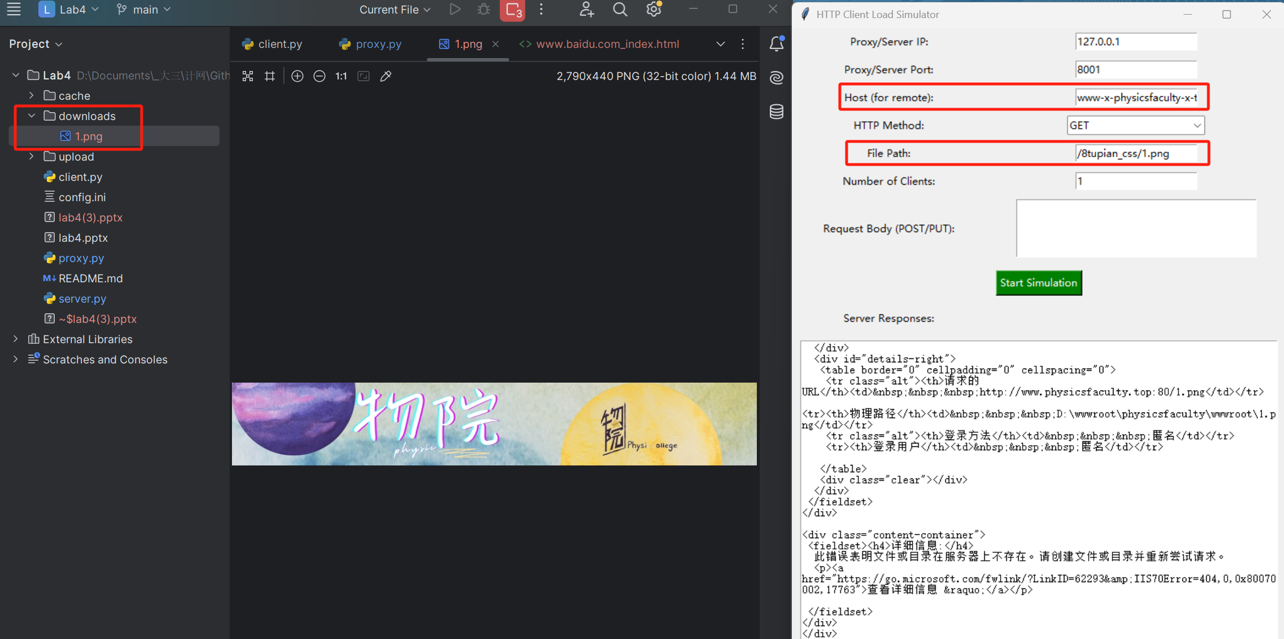

Prepare
client&server
proxy
test
conclusion
Crawl photos in our own website

Slide 17
04
PART
Testing

Slide 18





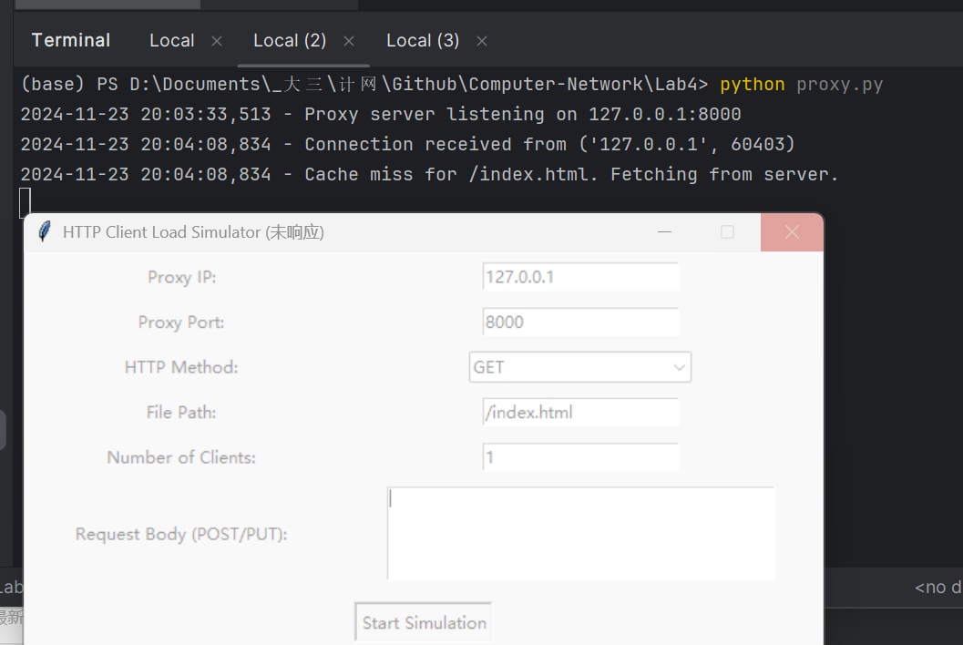
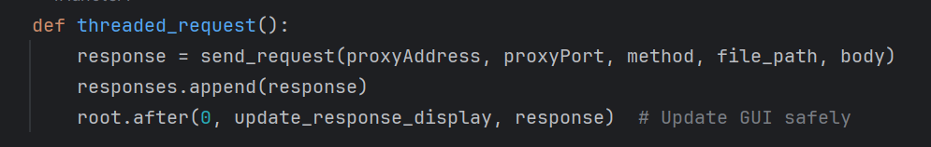
introduction
client
server
test
conclusion
Multiple problems have been solved
1. client.py can’t reply: The main thread is blocked
Possible Solution:
thread.join()
root.after()
Update the response_display asynchronously to ensure that the UI doesn't get stuck with data writes

Slide 19
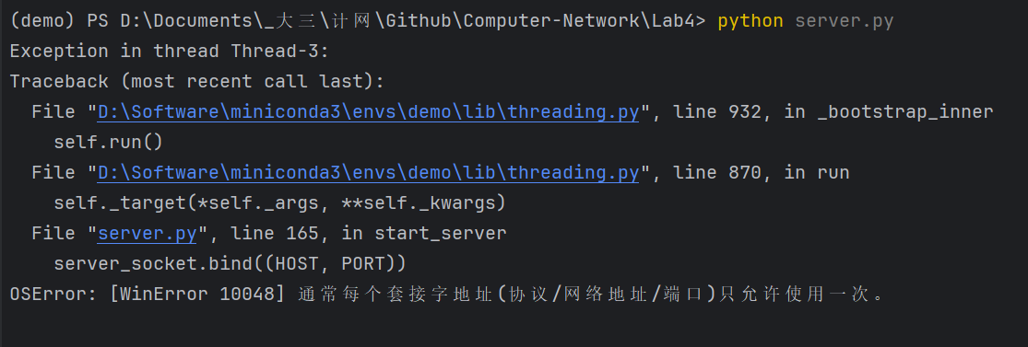
introduction
client
server
test
conclusion
Multiple problems have been solved
2. Socket parameter error:
Possible Solution:
Change the web server or proxy port

Slide 20
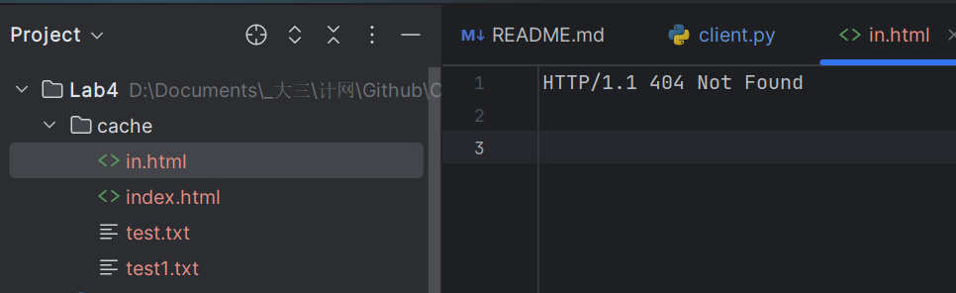
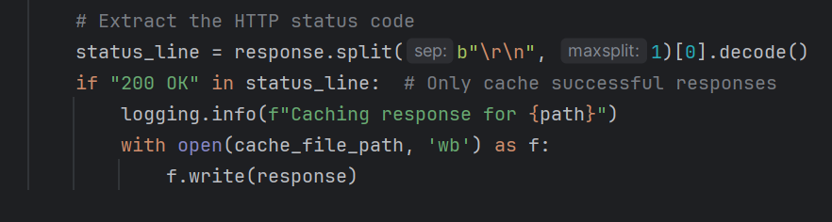
introduction
client
server
test
conclusion
Multiple problems have been solved
3. Unexpected storage in cache:
Possible Solution:
We only want to store the acessable file.
Add a new condition:

Slide 21
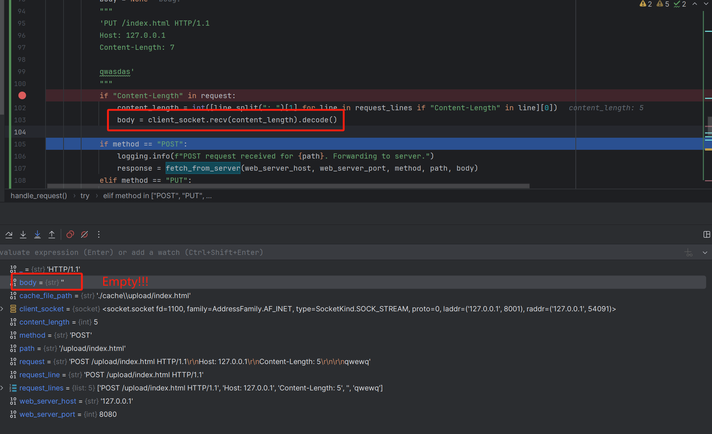
introduction
client
server
test
conclusion
Multiple problems have been solved
4. Post unsccessfully:

Slide 22
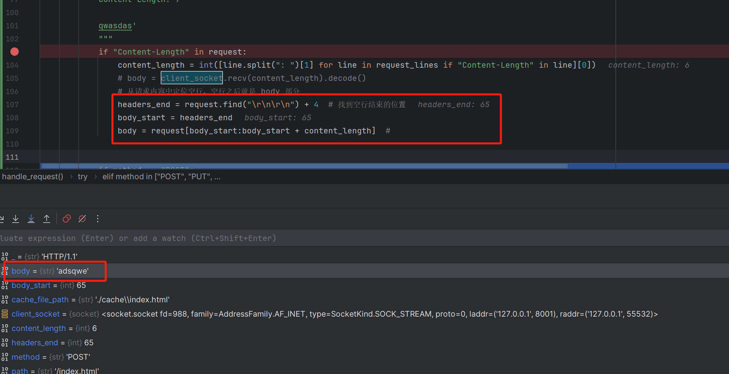
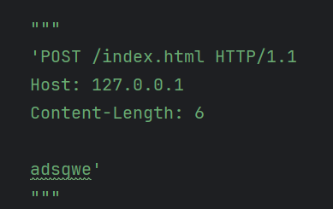
introduction
client
server
test
conclusion
Multiple problems have been solved
4. Post sccessfully:

Slide 23
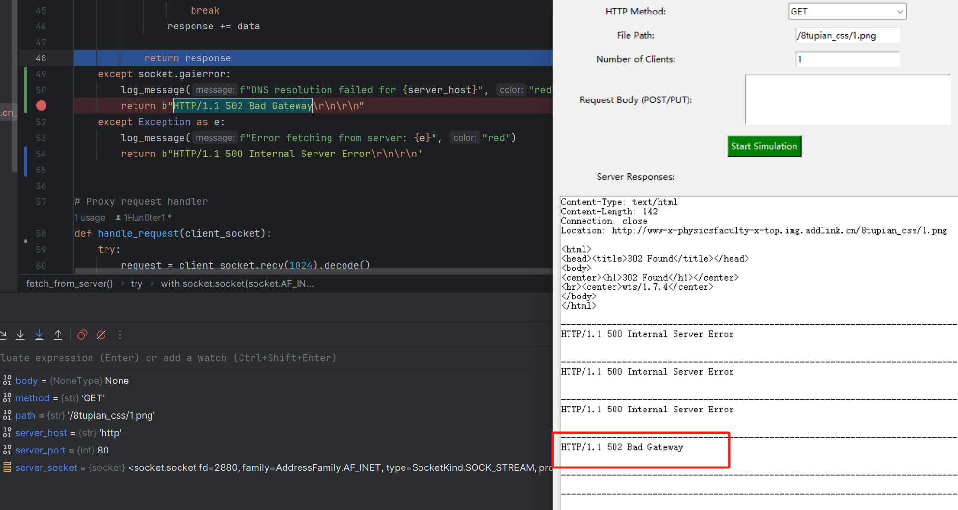
introduction
client
server
test
conclusion
Multiple problems have been solved
5. DNS resolution failed:

Slide 24
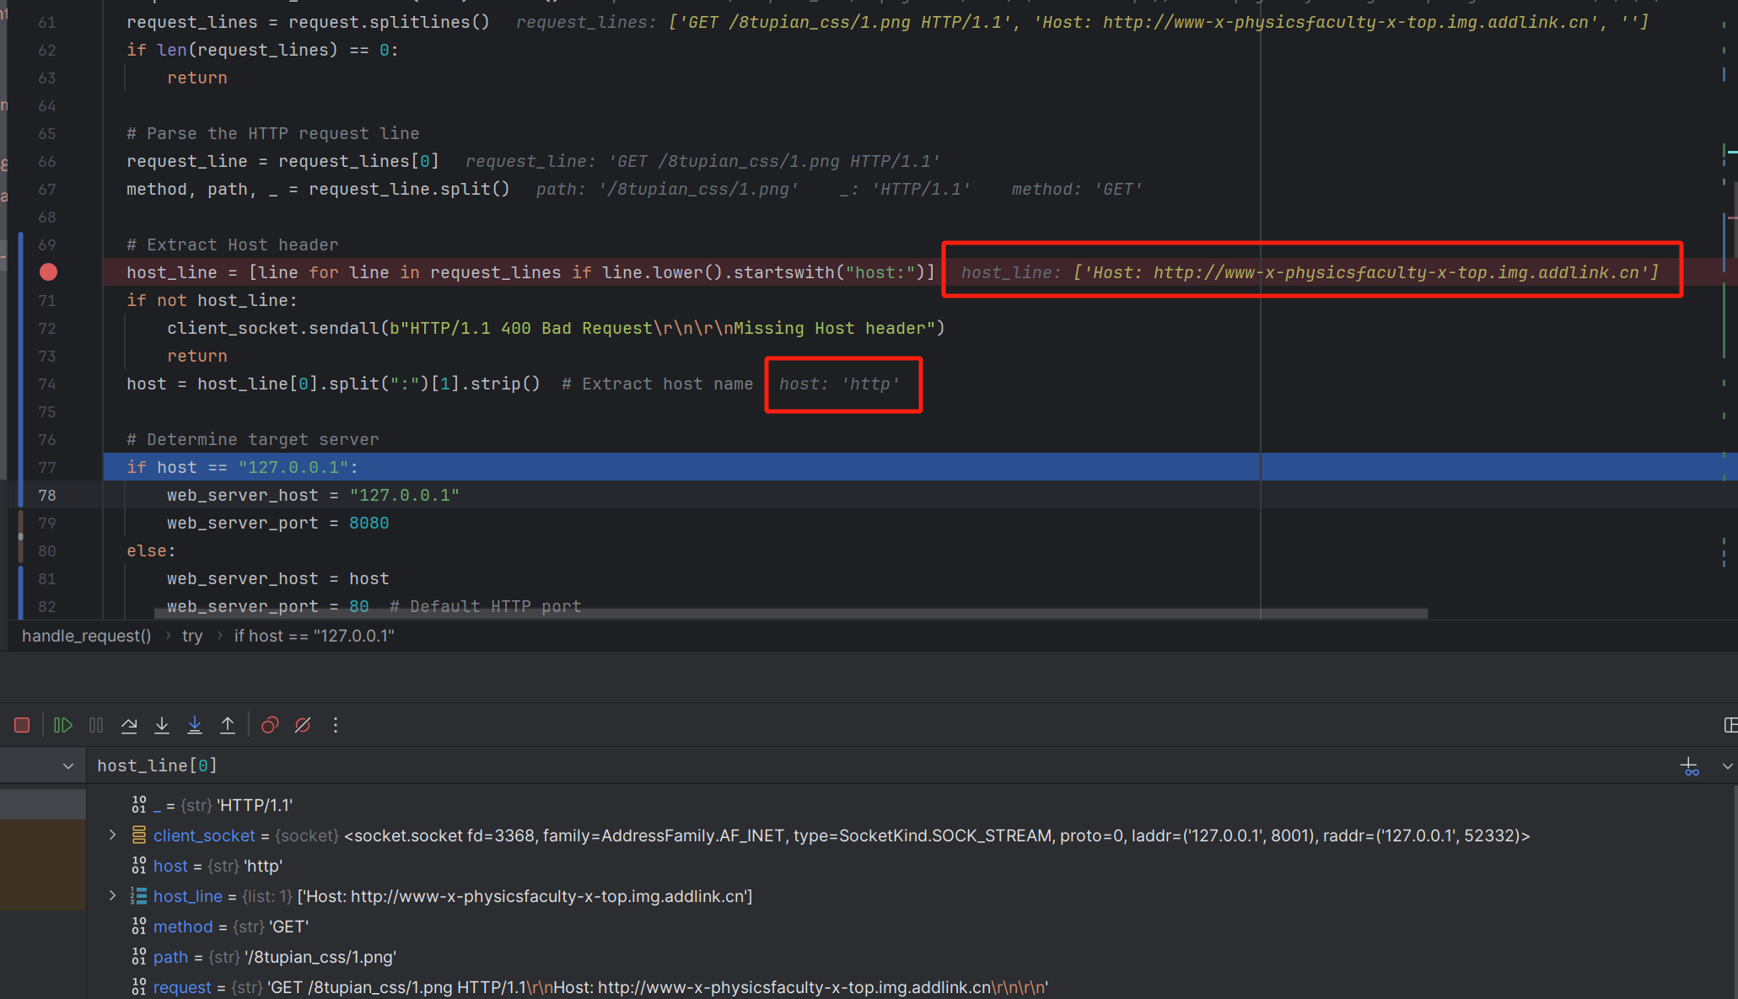
introduction
client
server
test
conclusion
Multiple problems have been solved
5. DNS resolution failed:

Slide 25
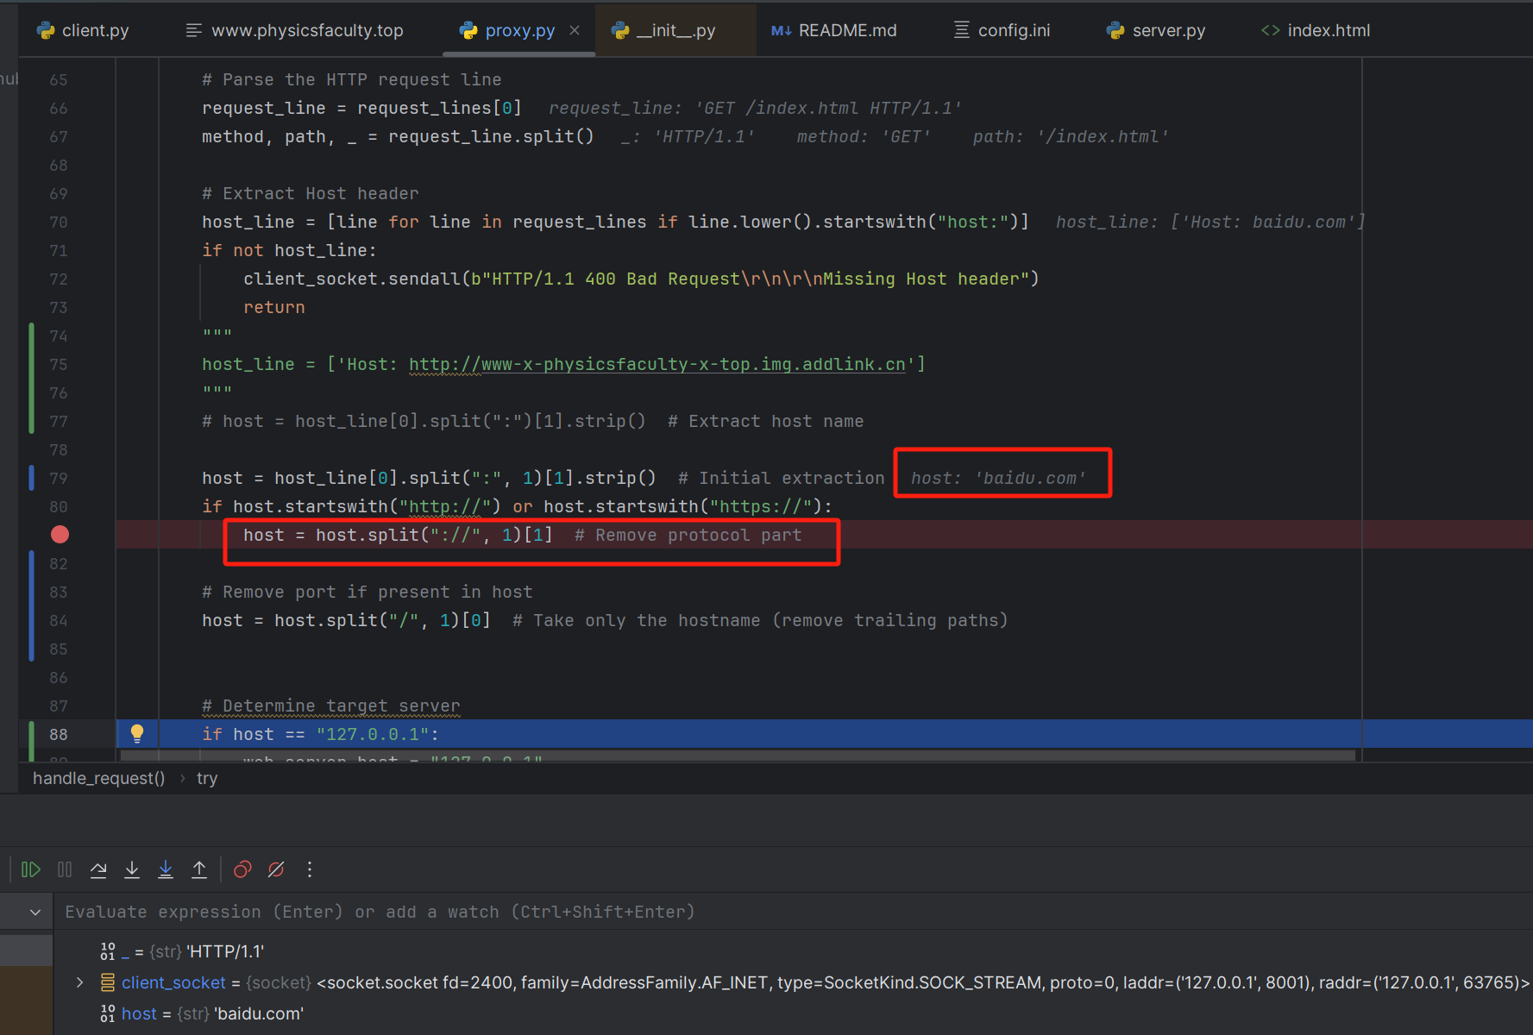
introduction
client
server
test
conclusion
Multiple problems have been solved
5. DNS resolution successfully:

Slide 26
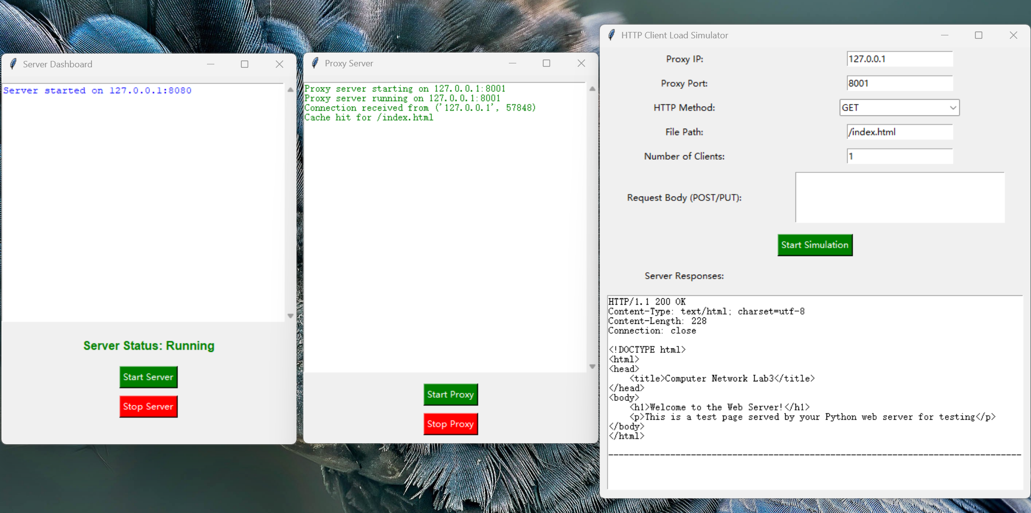
introduction
client
server
test
conclusion
Show the result
get method

Slide 27
05
PART
Conclusion

Slide 28


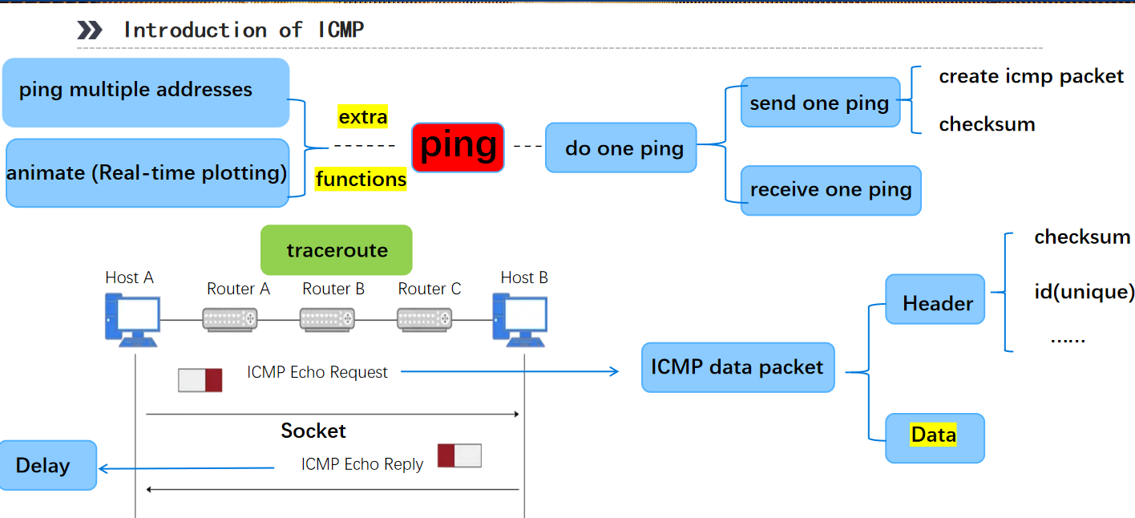
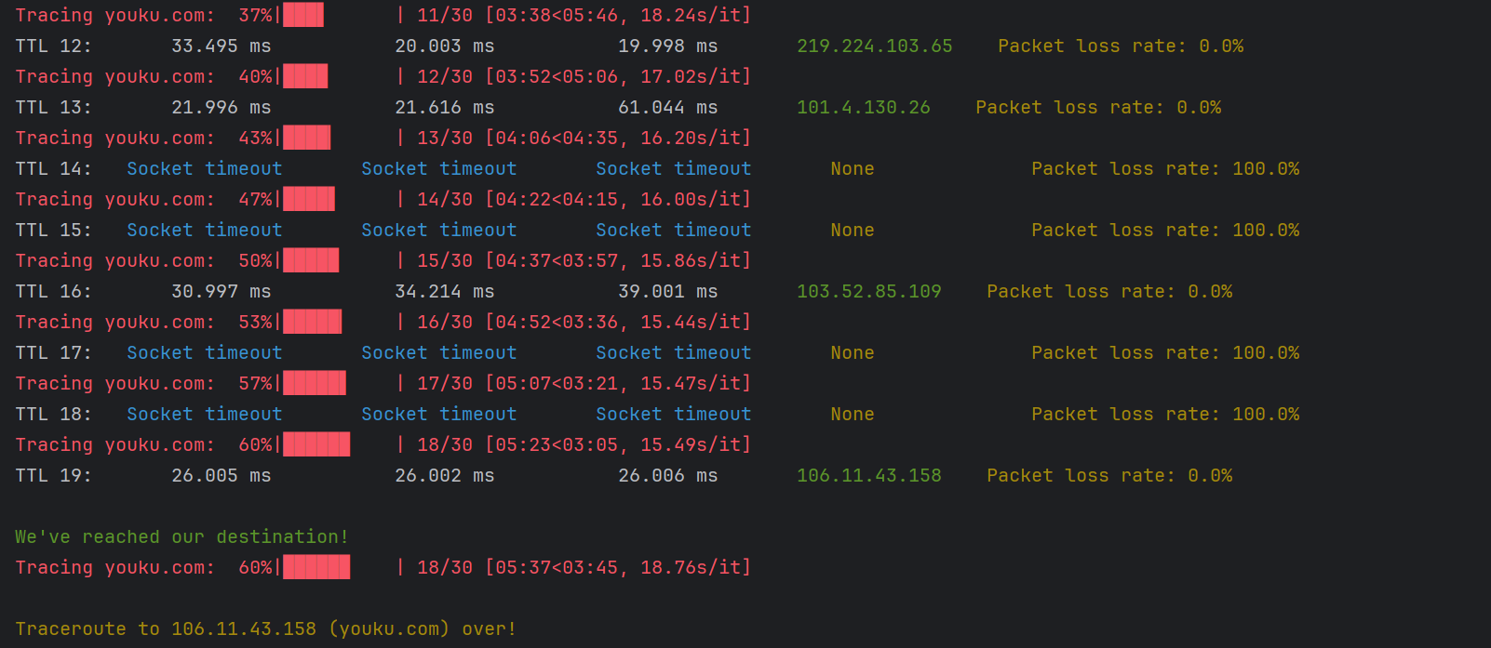
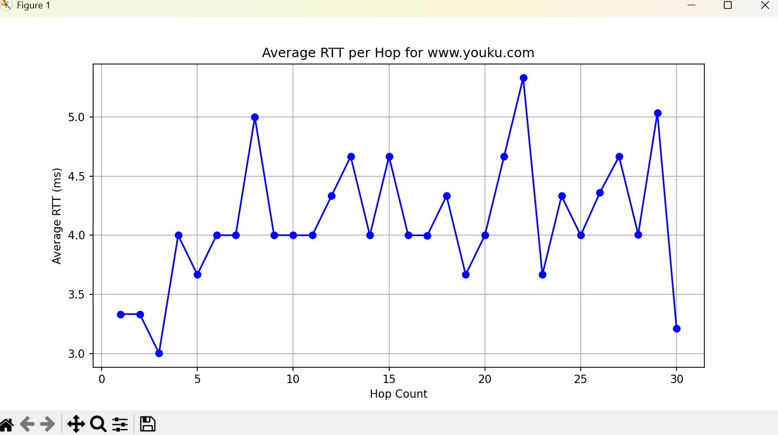
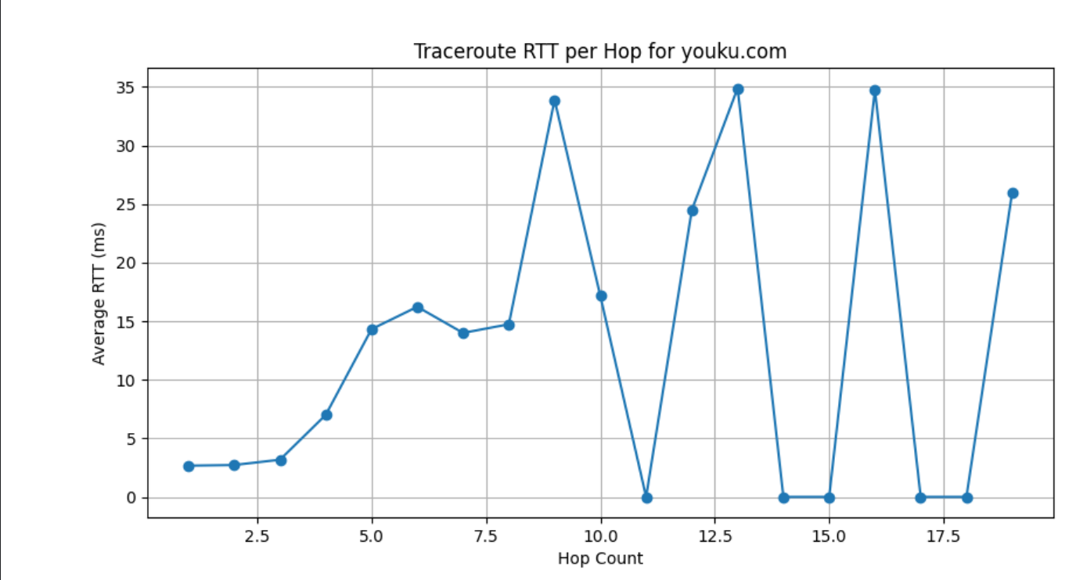
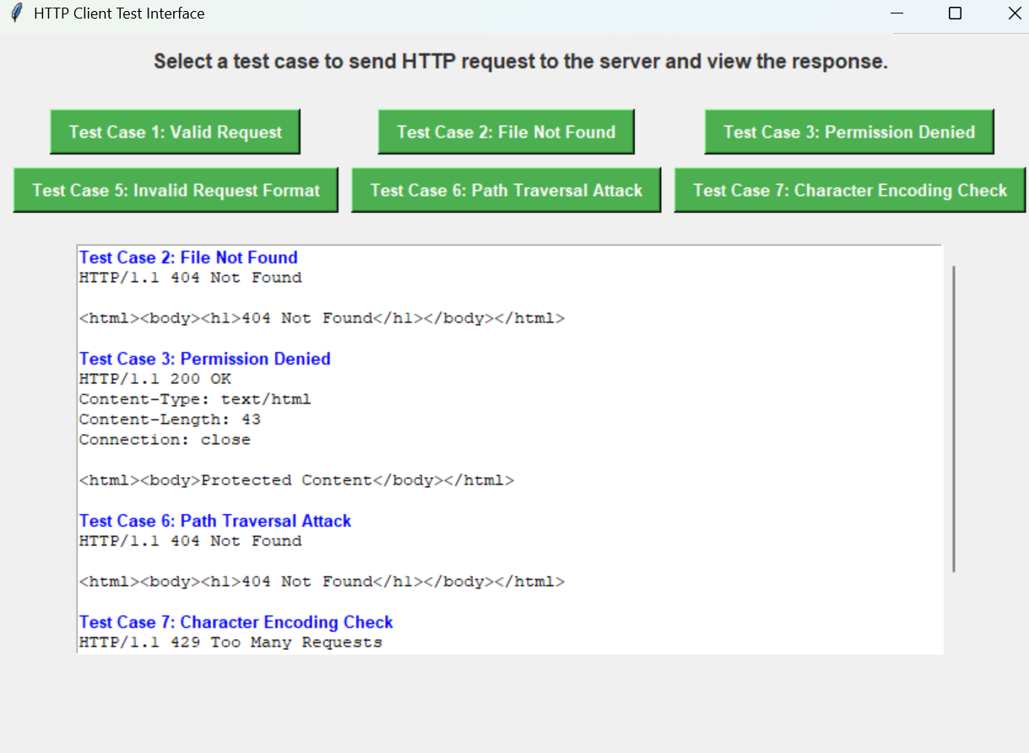
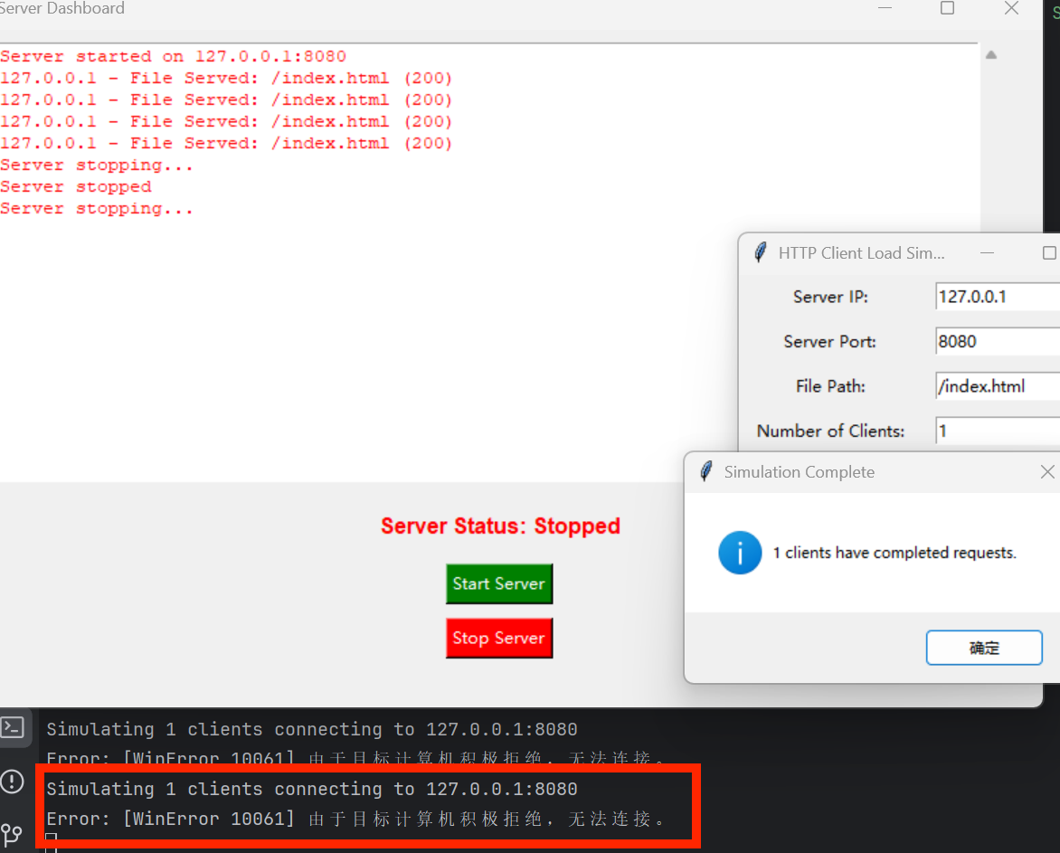
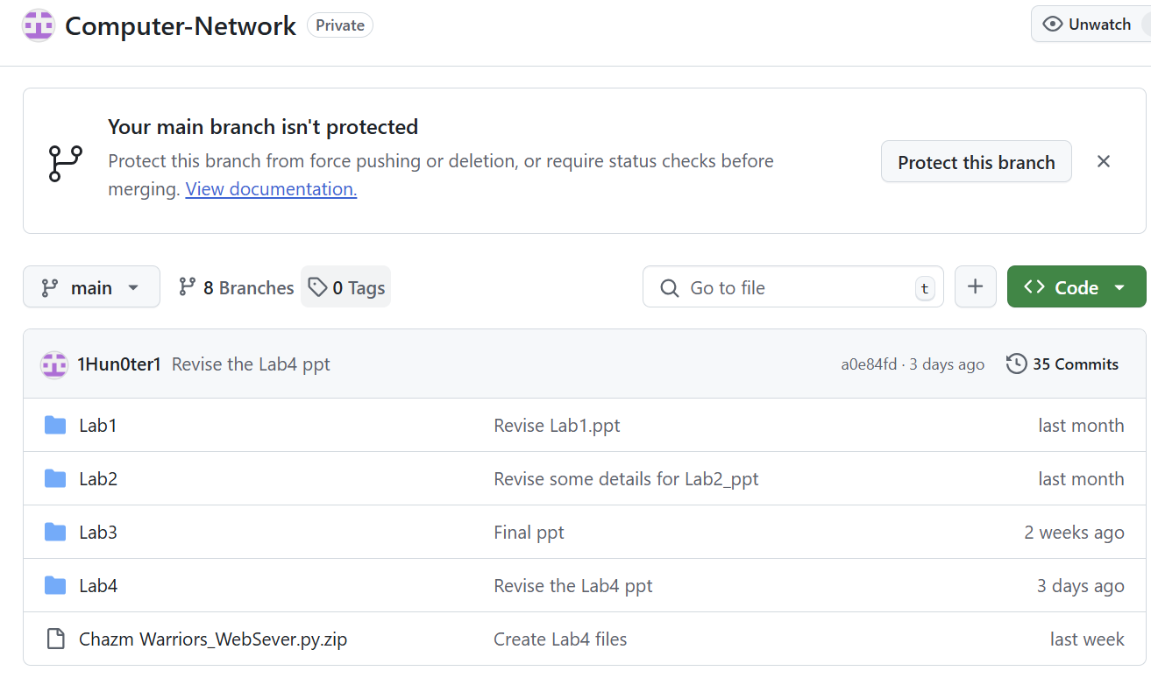
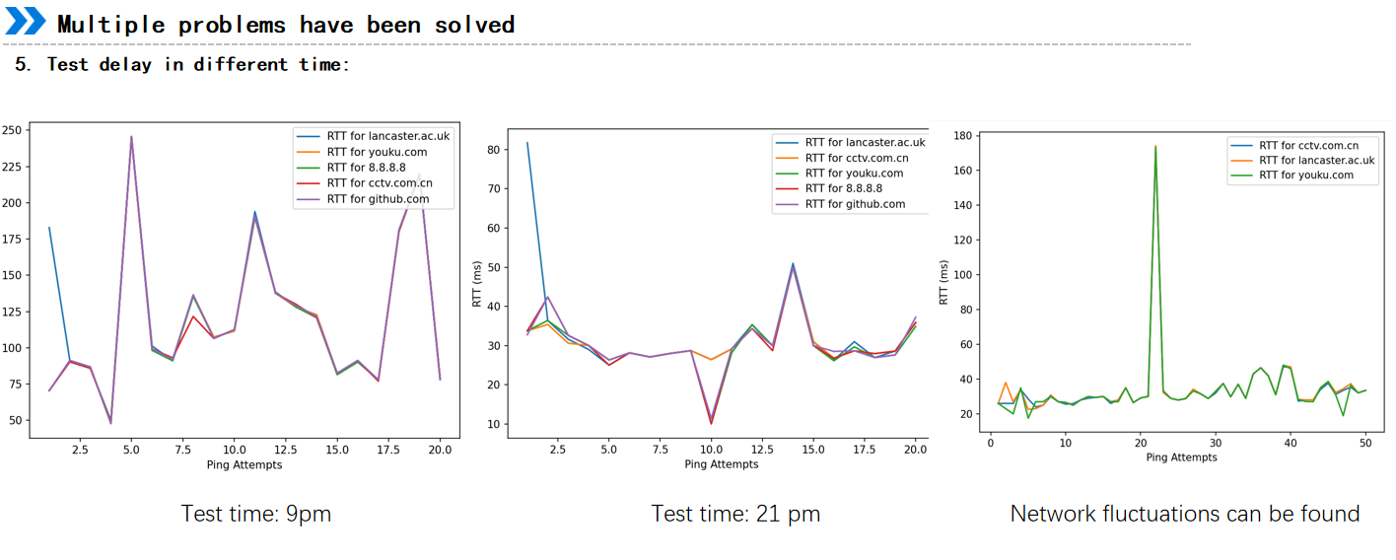
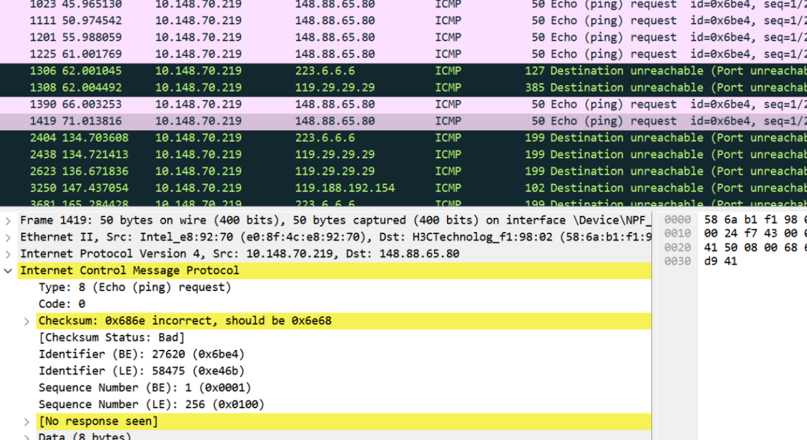
prepare
client
server
test
conclusion

Slide 29
Thank you!
Huang Hao, Zhou Yitong, Meng Yu, Chen Zijie, Wen Tianshu
2024.11.29

